Slide 1



AST/ACICT شركة التدريب
INSIGHTIFY Team
Olist Store Sales Analysis
Project
Contributors/Team
Abdulaziz Suleiman Abdulaziz
Mohamed Abdeltawab Mohamed
Ahmed Gamal Mohamed Elazhary
Doaa Khaled Abdelwahab
Abdelkarim Ramadan Ali
Omar Ayman Refaat

Slide 2

Project Contributions
Data Cleaning & Preprocessing and Presentation:
Mohamed Abdeltawab Mohamed Hassan
Abdulkareem Ramadan Ali
Analysis Questions & Insights:
Ahmed Gamal Muhammad Alazhary
Doaa Khaled Abdelwahab
Dashboard Development & Insights:
Abdulaziz Suleiman
Omar Ayman Refaat

Slide 3
Source: https://www.kaggle.com/datasets/olistbr/brazilian-ecommerce
Programs used: Power Query, Python, Microsoft SQL, Tableau

Slide 4
Background About Olist Dataset
Olist is a Brazilian e-commerce platform founded in 2015, aiming to empower small and medium-sized businesses to sell their products online.
Olist provides integrated solutions including inventory management, logistics, and customer service, making it easier for sellers to showcase their products on major e-commerce websites such as Mercado Livre, Amazon, and Americanas12.

Slide 5
Data Description
olist_geolocation_dataset: Contains information about the geographical location of customers and sellers, including zip code prefix, latitude, longitude, city, and state.
olist_order_customer_dataset: Contains information about customers, including customer ID, unique customer ID, zip code prefix, city, and state.
olist_order_dataset: Contains information about customer orders, including order ID, customer ID, order status, purchase timestamp, delivery dates, and estimated delivery date.
olist_order_items_dataset: Contains information about the items in customer orders, including order ID, order item ID, product ID, seller ID, shipping limit date, price, and freight value.

Slide 6
Data Description, Continue
olist_order_payments_dataset: Contains information about customer payments, including order ID, payment sequential number, payment type, number of installments, and payment value.
olist_order_reviews_dataset: Contains information about customer reviews of orders, including review ID, order ID, review score, comment title, comment message, creation date, and answer timestamp.
olist_products_dataset: Contains information about products, including product ID, category name, description length, photo quantity, weight, length, height, and width.
olist_sellers_dataset: Contains information about sellers, including seller ID, zip code prefix, city, and state.
product_category_name_translation: Contains a translation of product categories from Portuguese to English.

Slide 7
Data Cleaning & Preprocessing
Check NULLS & replace
Check Duplicates & remove
Drop unnecessary columns
Generate Factitious names for the Sellers to Enhance the Dashboard.
Generate Category names to classify the products.
Python
If appropriate
Power
Query

Slide 8
Initial Data Inspection
Overview of Dataset Structure:
Loaded dataset and inspected data types, column names, and structure.
Utilized info(), describe(), and head() functions for basic overview.
Seller Representation
Created a list of fictitious names for sellers to make them easily identifiable in the dashboard. Merged this list with the original sellers table.

Slide 9

Data Cleaning Decisions
Products Table:
Dropped unnecessary columns: product_name_length, product_length, height, width.
Customer Table:
Dropped customer_unique_id (duplicate of customer_id).
Order Reviews Table:
Dropped comment_title and comment_message columns, as they are irrelevant to the final model.
Order Items Table:
Categorized products into 24 sections (categories) using Power Query to align with the analysis.

Slide 10

Handling Missing Values & Duplicates
Order Dataset:
Missing values in order_approved_at, order_delivered_carrier_date, and order_delivered_customer_date are retained because they are naturally missing for orders with a status of "cancelled".
Products Table:
Replaced 610 NULLs in product_category_name with "Others" using Python.
Replaced missing values in product_weight with the median, as the data was not normally distributed.
Identified missing data using isnull().sum().
Handling Missing Values:

Slide 11

Duplicates Removal:
Checked for duplicates using duplicated().
Removed a significant number of duplicates in geolocationdataset (261,831 duplicate records), ensuring data accuracy for further analysis.

Slide 12
Data Type Conversion, Consistency,
& Final Validation
Data Type Conversion:
Converted columns (e.g., order timestamps) to suitable data types like datetime.
Ensured correct formatting for numeric, categorical, and text data.
Data Consistency Checks:
Standardized product categories and other text fields for consistency.
Aligned column formats across different datasets, ensuring smooth merging and analysis.
Final Validation:
Performed final checks for remaining issues after cleaning.
Saved the cleaned dataset, ensuring it is ready for further analysis and visualization.

Slide 13
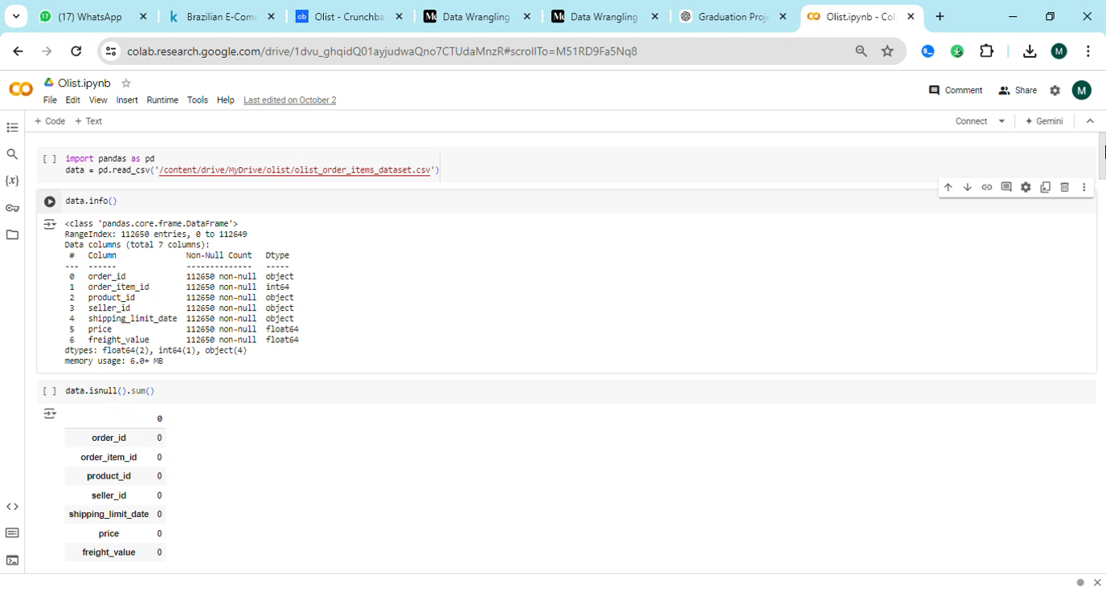

Slide 14
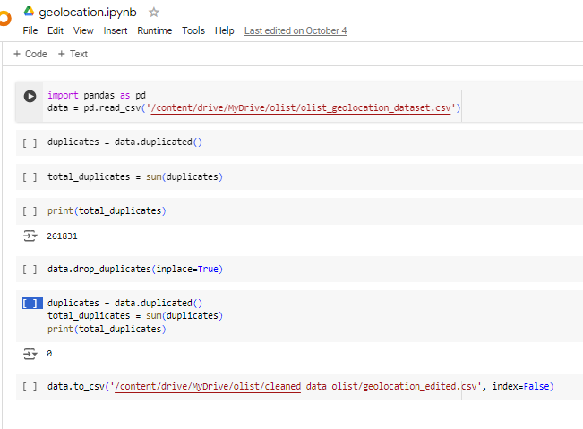

Slide 15

Data analysis
After the steps of data wrangling and cleaning in the previous steps.
Next we move into data analysis.
We will use this part to answers the business questions.

Slide 16

Why we do this analysis?
To optimize the performance of the company and to identify the strengths and weaknesses.

Slide 17
Notes:
This dataset contains data from 2016 to 2018.
This report will be sent to the Top Management.

Slide 18

Milestones
Analytical Questions Using SQL
We uploaded 7 sheets in csv form, and we had 1 excel sheet we changed its form to be csv so we can upload the file.
From (Tasks < Import flat file)
We had to change the data type for some columns

Slide 19
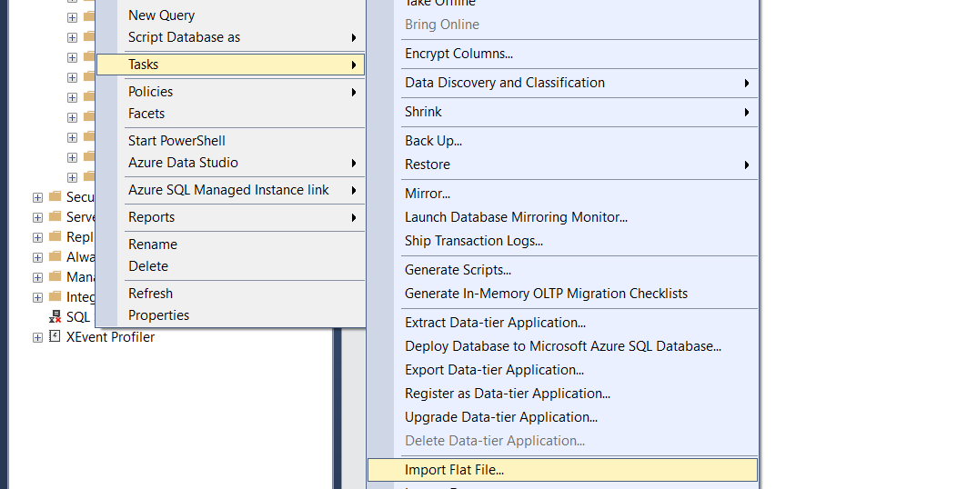

Slide 20
Sales Performance

Slide 21
What is the overall sales trend (revenue) over time?
We found that during the period from September 2016 to October 2018, the revenues fluctuated significantly, peaking at $1,194,882.80 in November 2017. There was a significant growth in annual revenues from $59,362.34 in 2016 to $8,699,763.00 in 2018. However, a sharp decline was observed in September and October 2018.

Slide 22
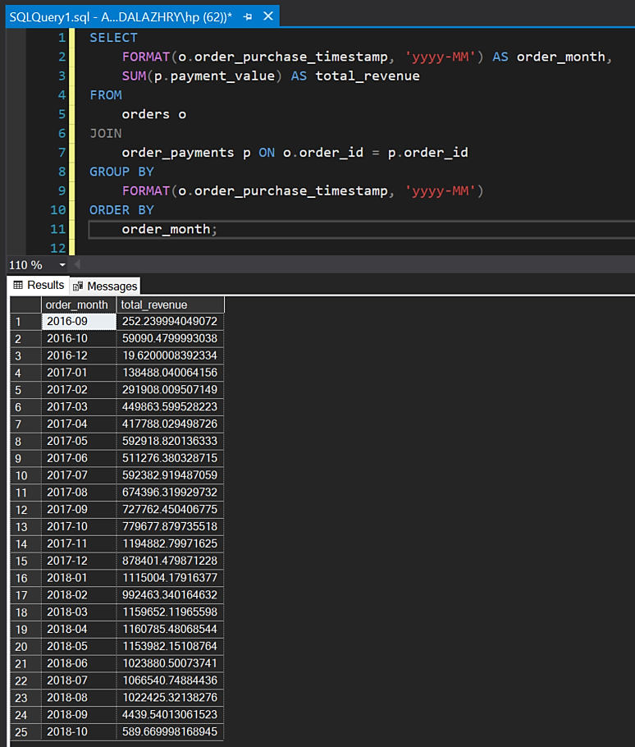

Slide 23

What are the top-selling product categories? (Top 5)
We found that the furniture_decor category was the highest selling category, with total sales of $481,915,077.43. The sports category was the fifth best selling category, with total sales of $138,332,663.99.

Slide 24
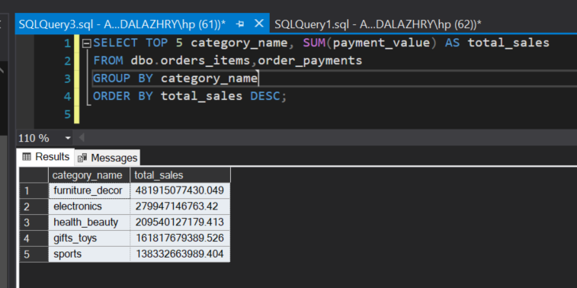

Slide 25

What are the worst-selling categories?
“Kitchen” was the worst selling category
$ 224,124,209.68

Slide 26
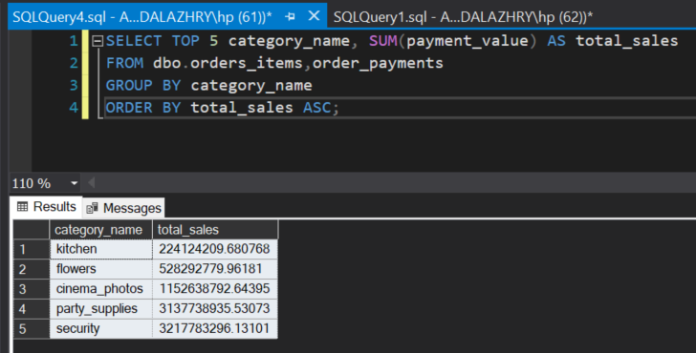

Slide 27

Who are the top 10 sellers based on sales?
Donald Evans topped the list with the highest sales of $507,166.91.
Sales varied widely among the top
ten sellers.

Slide 28
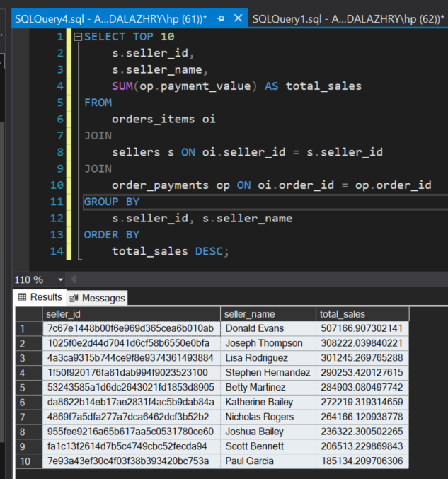

Slide 29

Which regions (based on customer geolocation) generate the most revenue? (Top 5)
Sao Paulo topped with $2,203,373.09 in revenue.

Slide 30
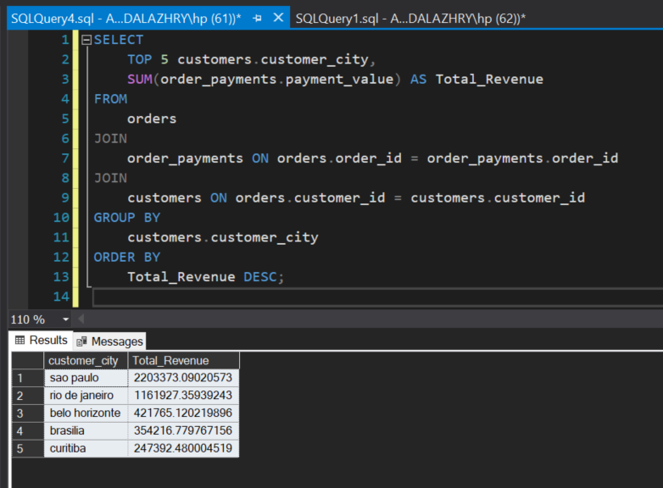

Slide 31
Customer Behavior

Slide 32

What are the top 5 review categories?
We found that
our top review category
is utilidades-domesticas
(Housewares)

Slide 33
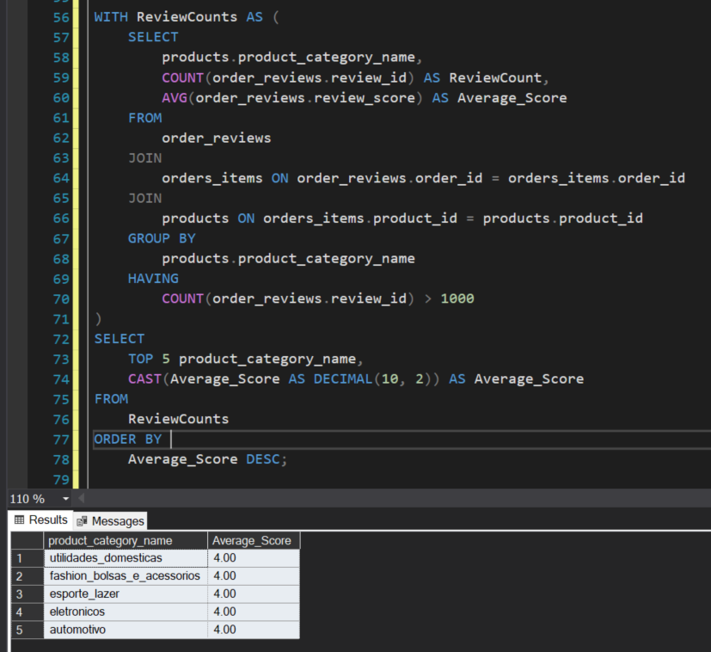

Slide 34

What is the contribution of each payment type to overall sales? (The preferred payment method for our customers)
Credit card
is the preferred payment method
for our customers at 78.34%.

Slide 35
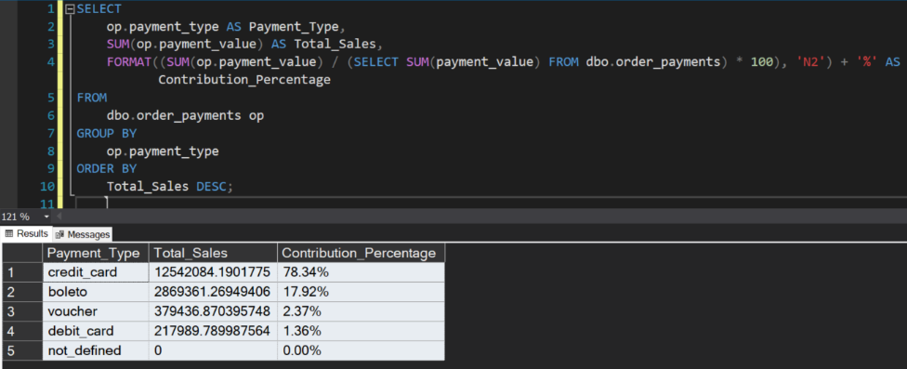

Slide 36
What is the average order value (AOV) and how has it changed over time? (from 9/2016 to 10/2018)
2017
is considered the highest revenue, but this is according to the attached data.

Slide 37
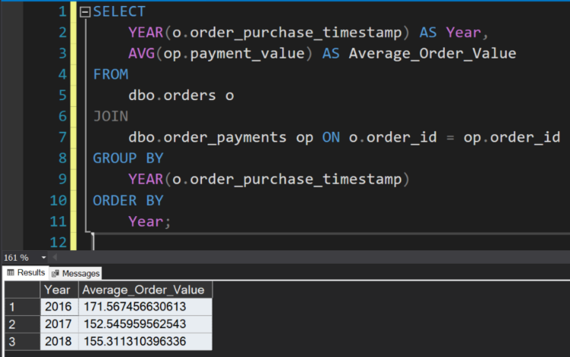

Slide 38
Seller Performance and Geographical Insights

Slide 39
How many sellers per state and how many orders and sales?
Sales and orders were distributed across several states, with the highest numbers being recorded by São Paulo (SP) with 1,849 sellers, 83,854 orders and sales of R$13,369,880.61. Paraná (PR) followed with 349 sellers, 9,014 orders and sales of R$1,846,047.66. While the lowest numbers were recorded by states such as Acre (AC) and Amazonas (AM) with only one seller and sales of less than R$1,300.

Slide 40
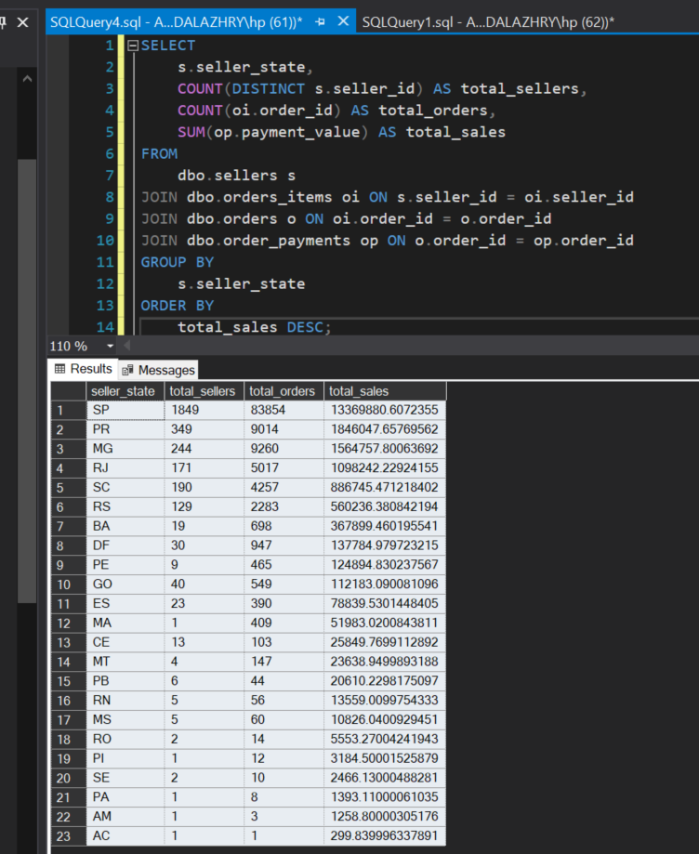

Slide 41
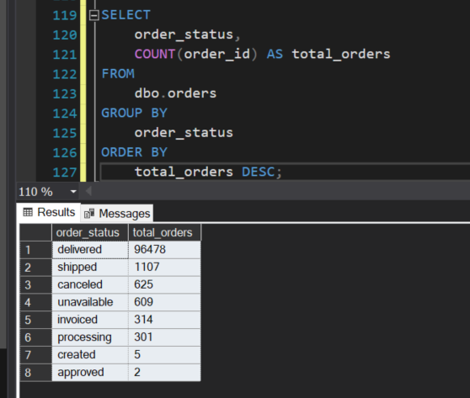
What are the most common order status (e.g., delivered, canceled, etc.)?

Slide 42
Logistics and Time Analysis

Slide 43
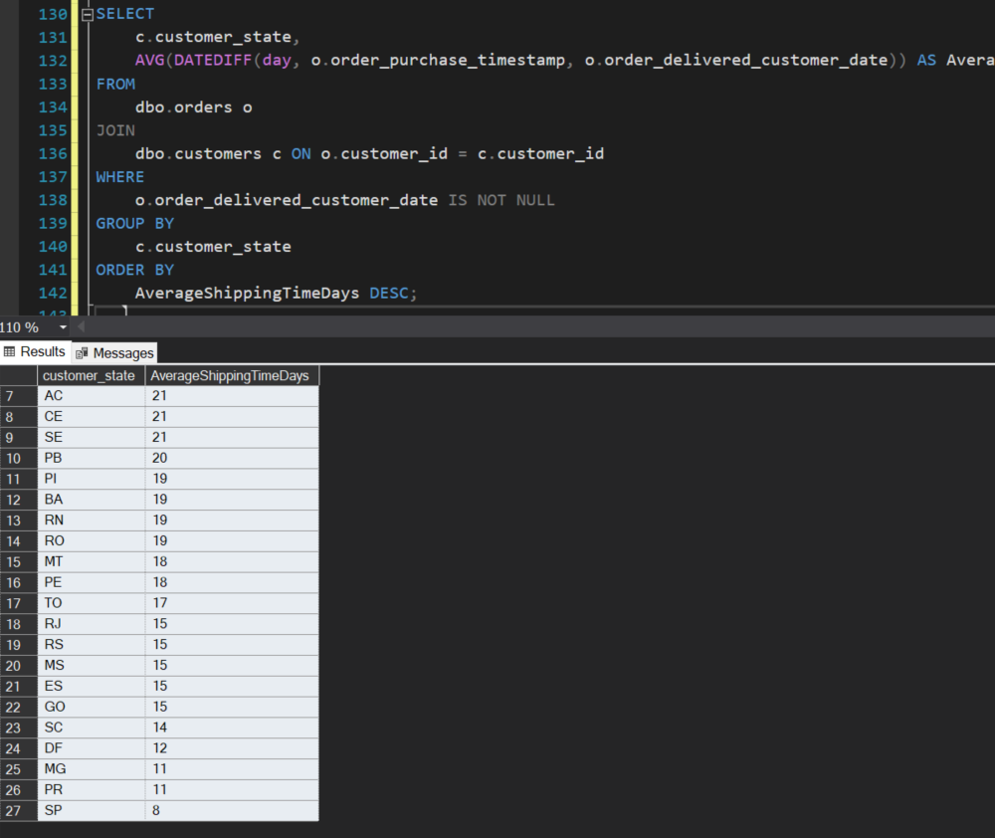
What is the average shipping time, and how does it vary by region?

Slide 44
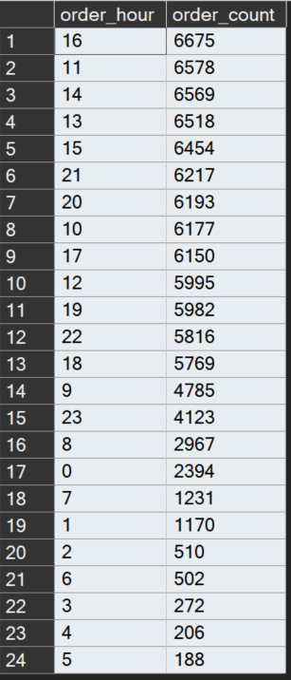
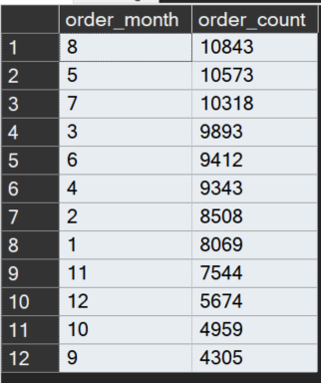
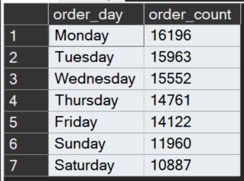
What is the time period which we receive the highest number of orders?
(hours/days/month)

Slide 45
Delivery Timeliness and Customer Satisfaction

Slide 46
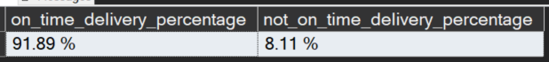
What is the percentage of the on time delivered orders and what is the percentage orders that are not delivered on time?

Slide 47
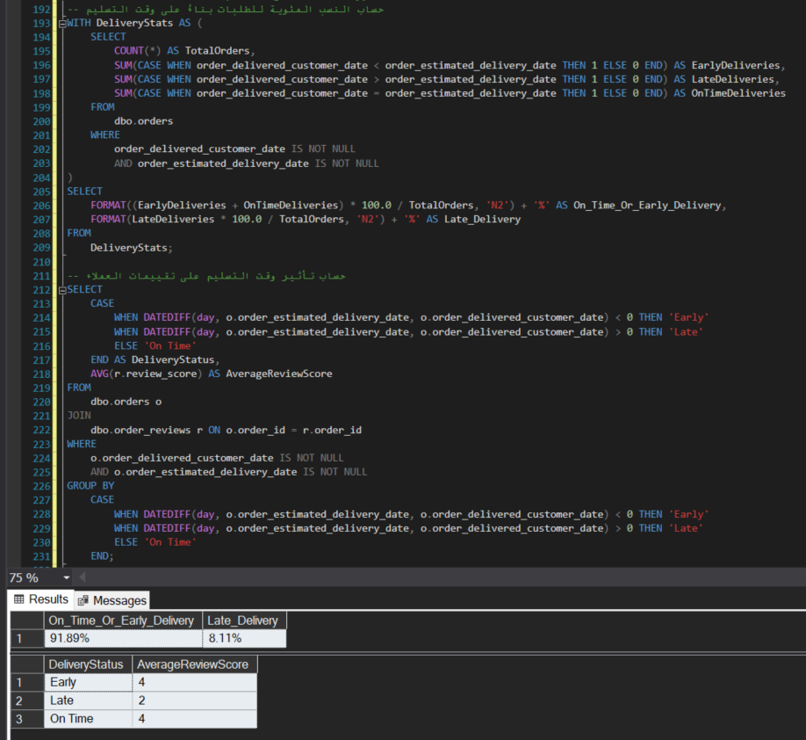
What is the percentage of the early, on time and late orders and how this affect the customer reviews?

Slide 48
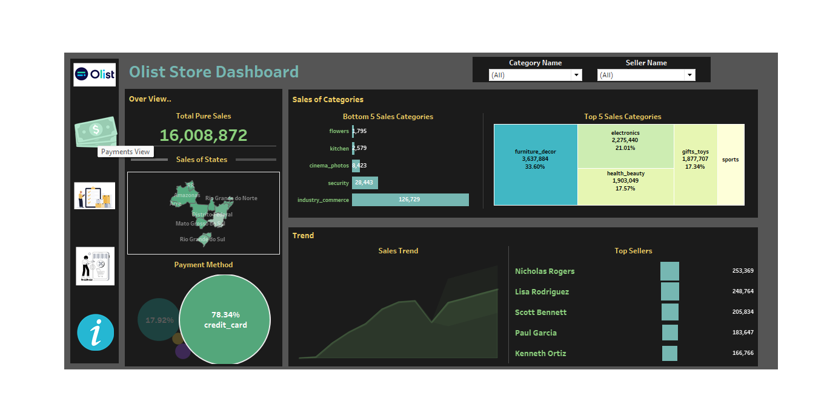
Dashboard Using
Tableau

Slide 49
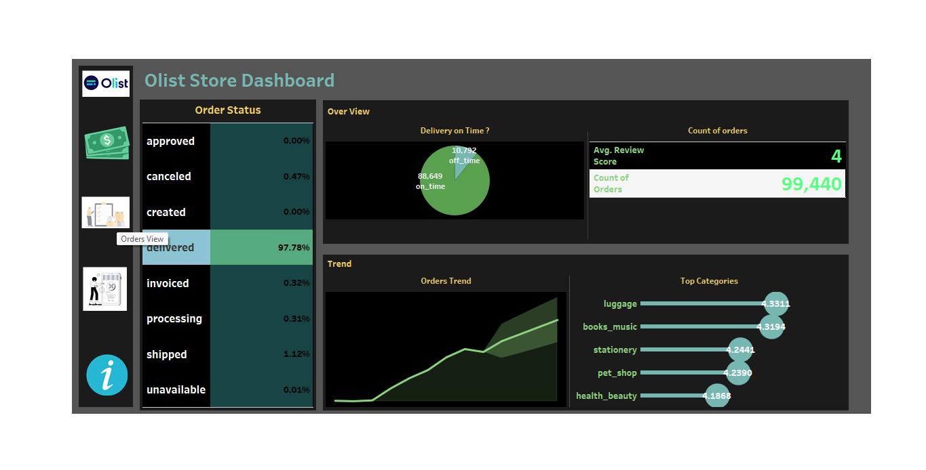
Dashboard Using
Tableau

Slide 50
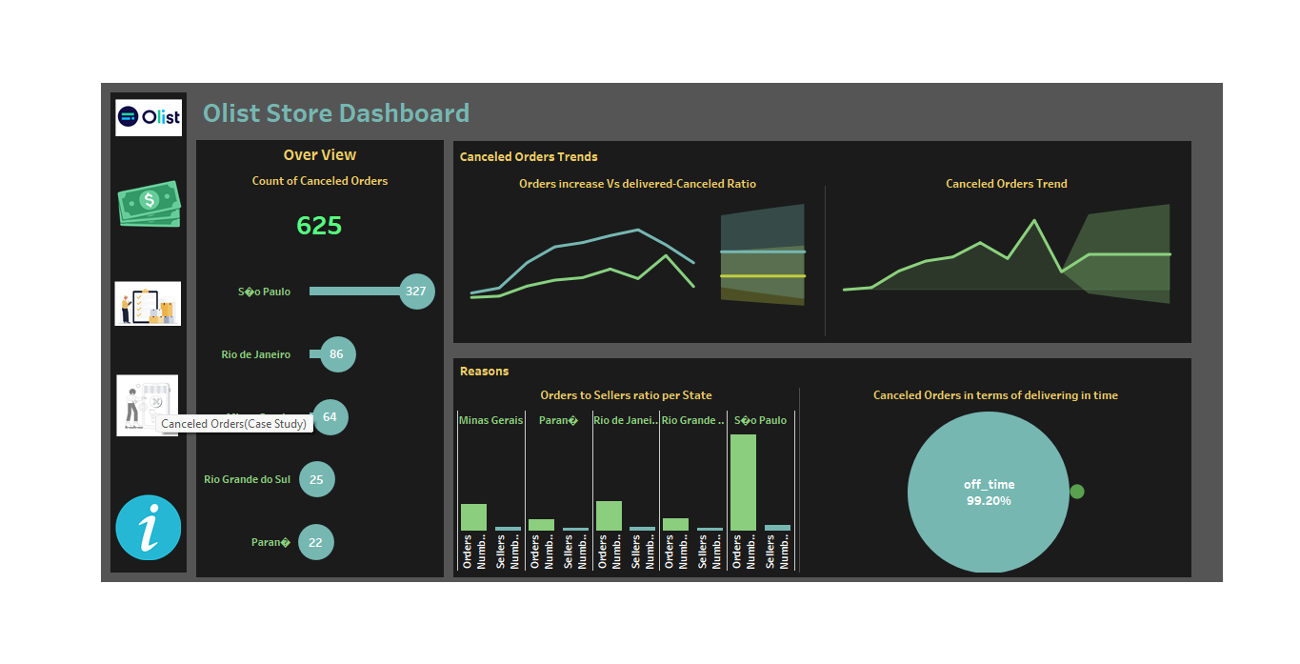
Dashboard Using
Tableau

Slide 51
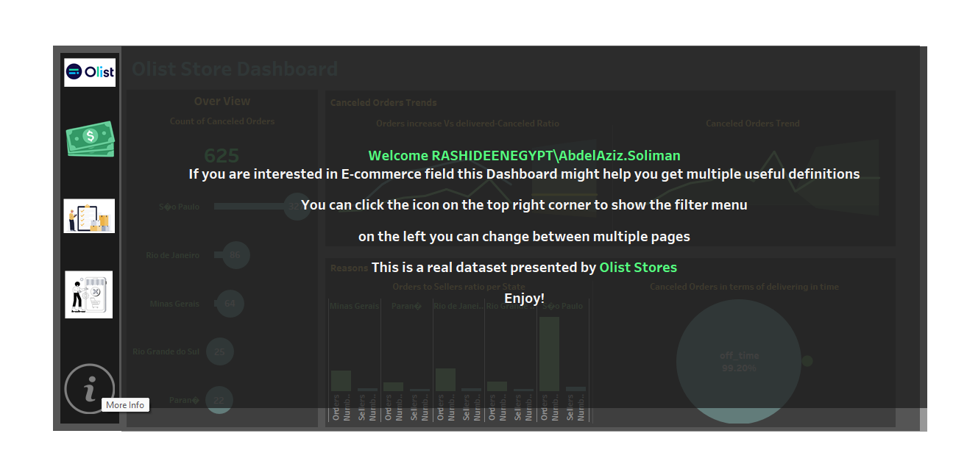
Dashboard Using
Tableau

Slide 52
Thanks

